Slide 1
Getting the CoVid-19 Vaccine
Find Press it to turn red when you aren’t talking.
Have a paper and pencil ready to use
HEALTH LITERACY WORK GROUP

Slide 2
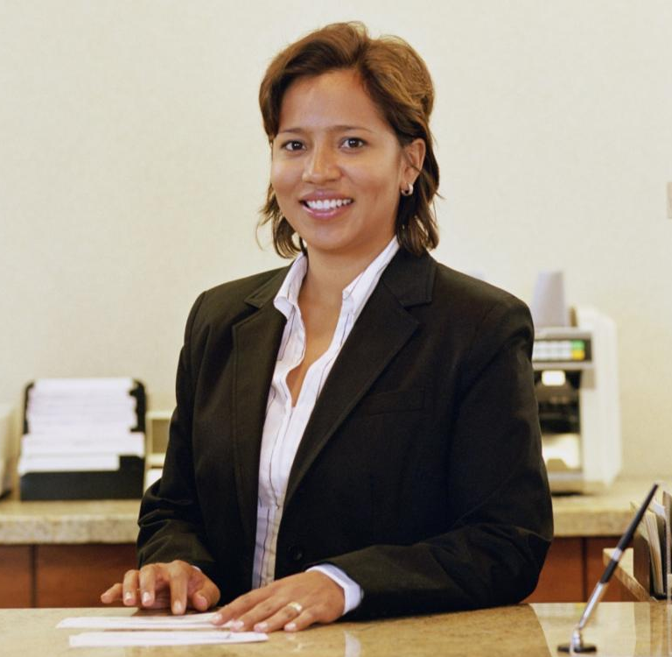
What Happens When You Go for Your Vaccine?
“When it is your time you will get a call or an email. You may need to set up a time online or you may talk to someone who sets it up. You will need to bring a picture ID with you.”

Slide 3
Come by Yourself
Unless: You need help
Or You are a minor (bring your parent)

Slide 4
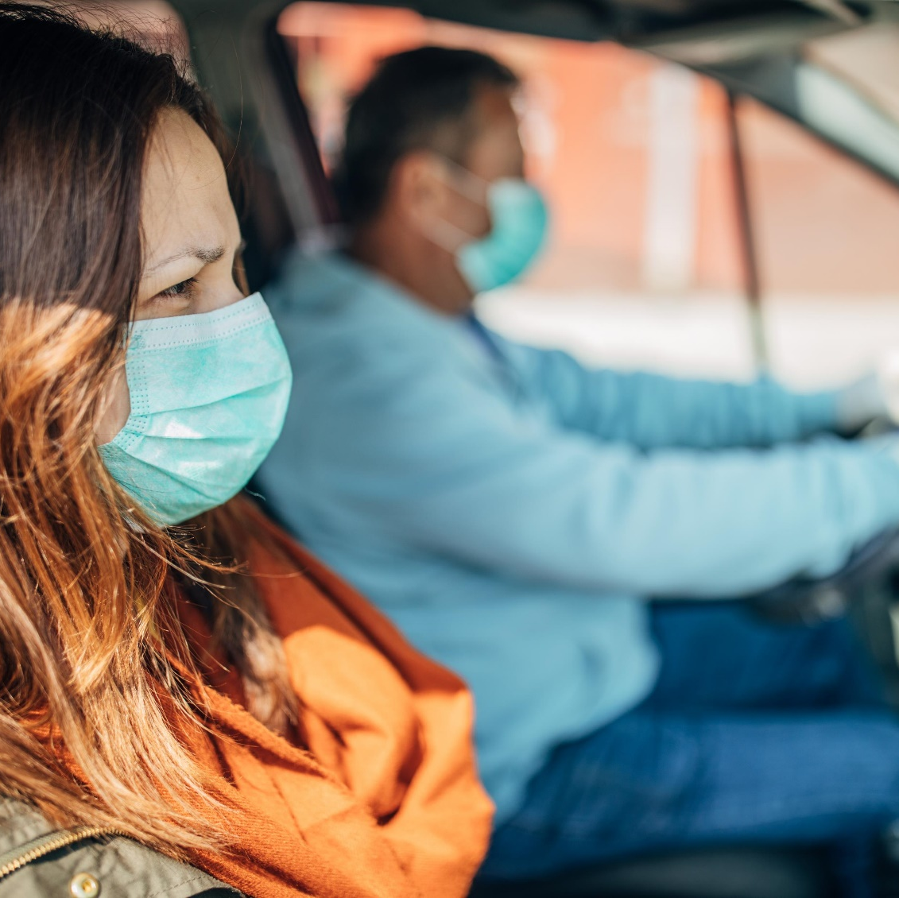
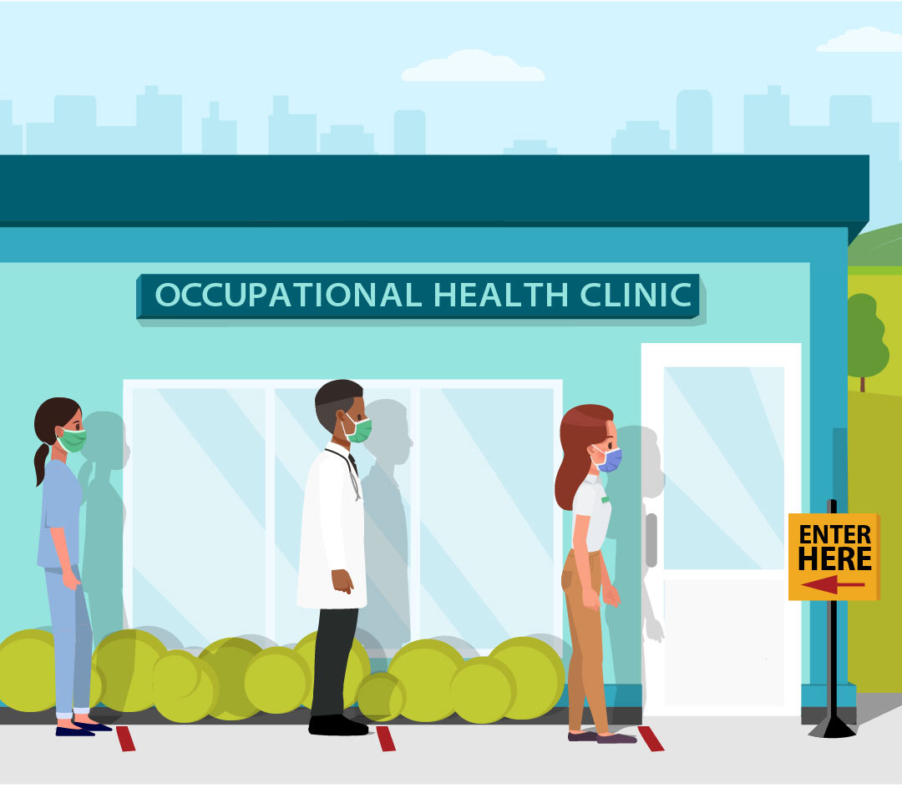
Vaccines are often given in a big place, like a clinic, a church, or even a drive through in a plane hangar. Kalamazoo is using the Expo Center, hospital property, a church, and pharmacies
Going to Get Your Vaccine
Always wear a mask and socially distance

Slide 5
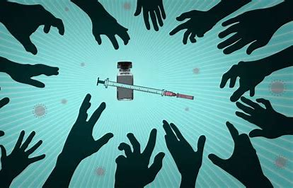
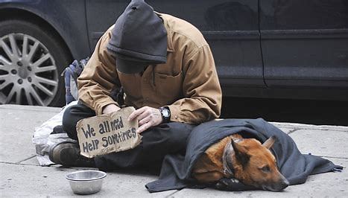
Everybody Who lives in the United States in Encouraged to Get Vaccinated
This includes:
People who are Homeless
People who are undocumented immigrants

Slide 6
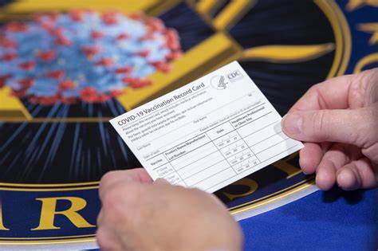
Who Gets My Information?
The Centers for Disease Control registers the names of everyone who gets any vaccine. Health providers can look this up before they offer a new one or if you can’t remember if you got it. It only has your name, when you got the vaccine, and which vaccine you got.

Slide 7
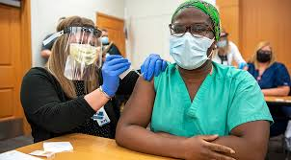
Getting Vaccinated
They will ask:
if you have any symptoms of Covid 19 or have been around anyone who is sick.
to see your ID card to make sure it is you
what arm you want it in (Keep in mind your arm may be quite sore after the shot)
If you want to bill your insurance

Slide 8
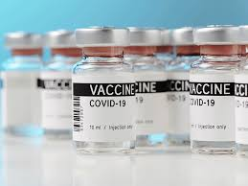
The vaccine is free. The government paid for it with money from taxes.
You can say “yes” or “no” to billing your insurance. You will still not pay anything.
Health insurance, Medicare or Medicaid can help to pay for giving the vaccine and save the taxpayers money.
.

Slide 9
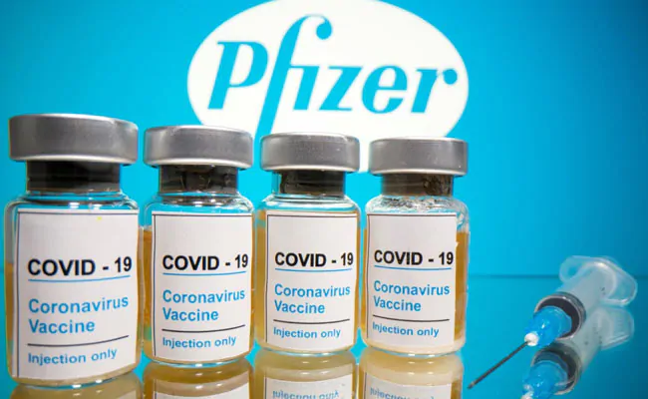
You will get one of three vaccines (you don’t get to pick).
Others may be coming soon
Two shots the second one is 3 weeks after the first
Two shots the second one is 4 weeks
after the first

Slide 10
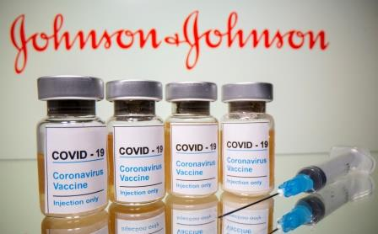
You will get one of three vaccines (you don’t get to pick).
Others may be coming soon
Janssen COVID-19 Vaccine (Johnson and Johnson)
Single shot
Latest vaccine to become available

Slide 11
Before you Leave the Vaccination Site
You will get a vaccine card for your records
They will give you a phone number where you can report any side effects
They will set up a time for your next appointment
They will ask you if you want to bill your insurance (you don’t have to- the shot is free- but insurance can help to lower the cost.
You have to stay for 15 minutes after the shot to watch for side effects.

Slide 12
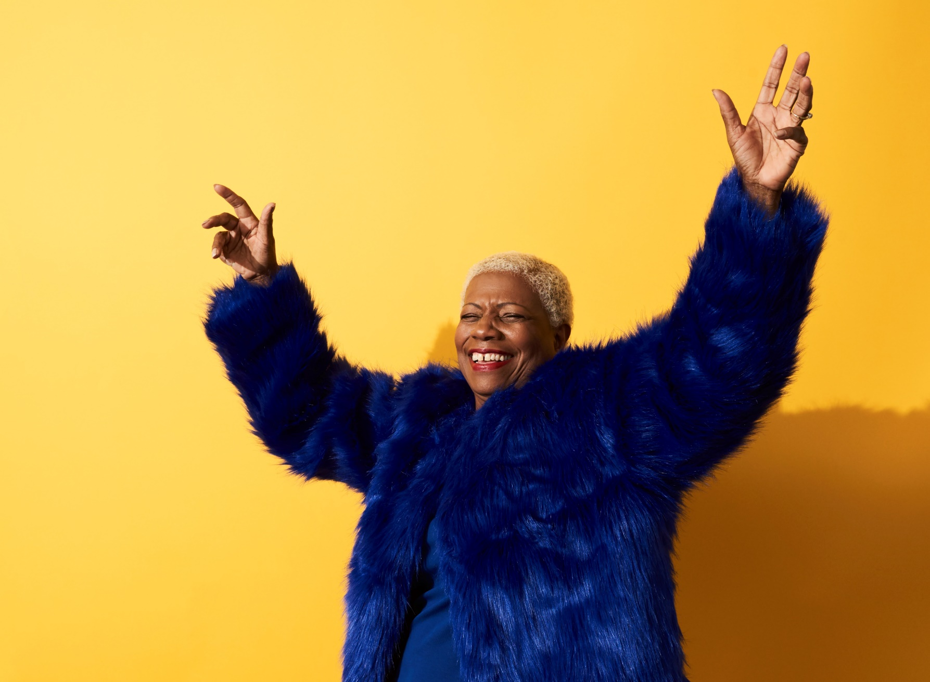
After the Vaccine
You are fully vaccinated two weeks after your final shot
After the second shot for Moderna and Pfizer
After the only shot for Johnson and Johnson

Slide 13
Inside without masks
With others from one unvaccinated household (without high risk members)

Slide 14
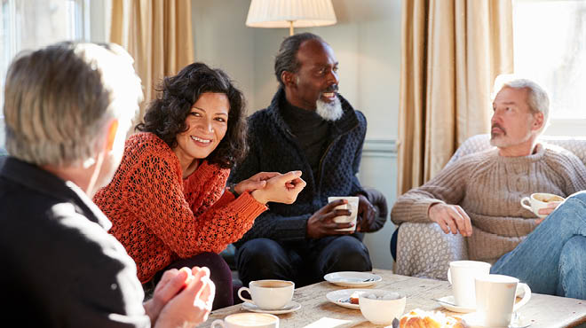
Inside without masks
With fully vaccinated people

Slide 15
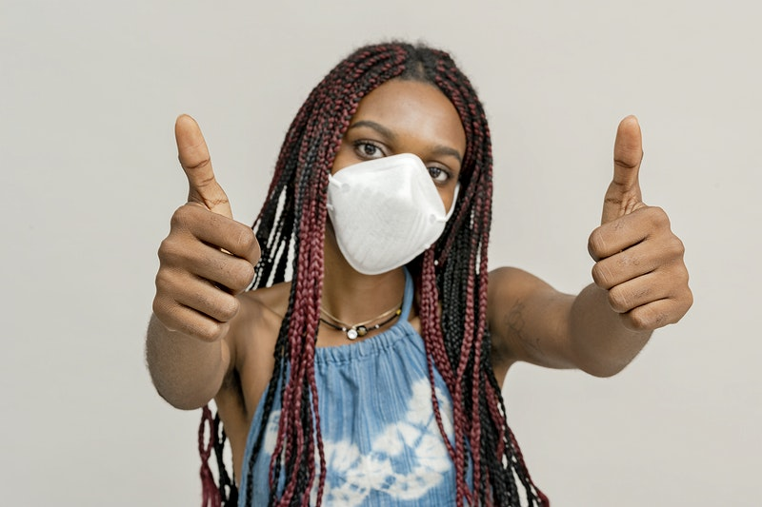
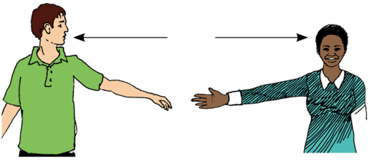
In Public and With Others
Social Distance
Wear a Mask
Wash Your Hands
Know that no vaccine is 100% effective
This Photo by Unknown Author is licensed under CC BY-SA-NC

Slide 16
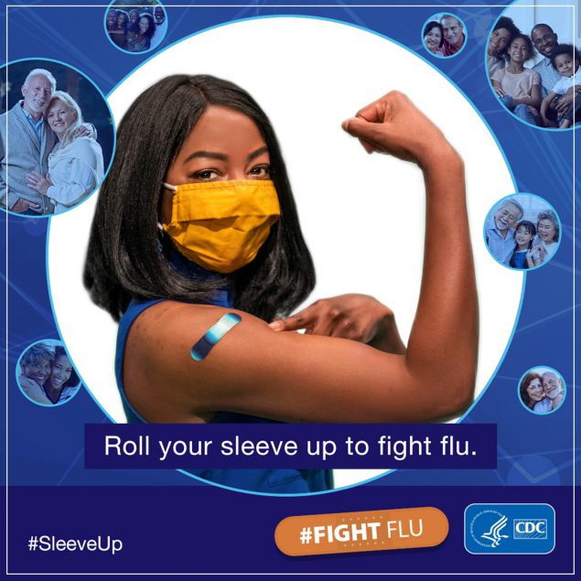
Tell Others
You did your part to Stop the Pandemic!
Covid
#Fight Covid

Slide 17
Stay Healthy!
Developed by:
Dr. Doris Ravotas
Fulbright Specialist
Master Faculty Specialist Emeritx
School of Interdisciplinary Health Programs
College of Health and Human Services
KLC Leader of Health Literacy Tutor Forum
Email: doris.ravotas@wmich.edu
HEALTH LITERACY WORK GROUP

