Slide 1
Welcome!
Read and Seed
Seedfolks Chapter 1: Kim and Activities!

Slide 2
Read and Seed
Today’s Plan
Introductions
Vocabulary
Seedfolks Ch. 1 Discussion
Class Activity

Slide 3
Read and Seed!
Getting to know YOU!
What is your name?
One Fun Fact About You!!

Slide 4
Read and Seed!
Class Agreements
Speak from your experiences
Listen without judgement
Participate
Have Fun!!

Slide 5
Read and Seed!
Vocabulary
Perspective: the way you see or understand something
Stern: serious, hard
Peering: looking closely at something
Vacant: empty
Hovered: hang around
Pods: oval shell
Plump: fat and round
Sprouted: to grow
Thrive: to bloom, to do a good job

Slide 6
Read and Seed!
Vocabulary - Let’s Practice!
Perspective
Plump
Stern
Sprouted
Thrive
Fat and round
Serious, hard
To bloom, to do a good job
To grow
The way someone sees or understands something

Slide 7
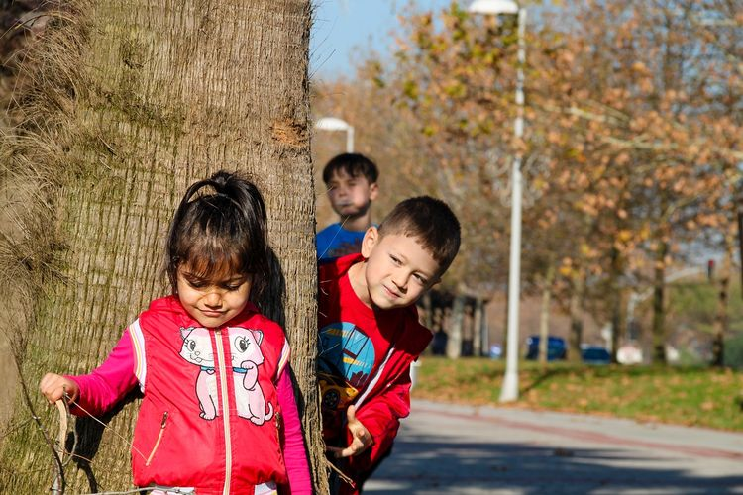
Read and Seed!
Chapter One: Kim
Why does Kim decide to start a garden?
What was your favorite part of this chapter? Why?

Slide 8
Read and Seed!
Describe your experience with gardens or farming? Can you think of any ways gardening might affect people?

Slide 9
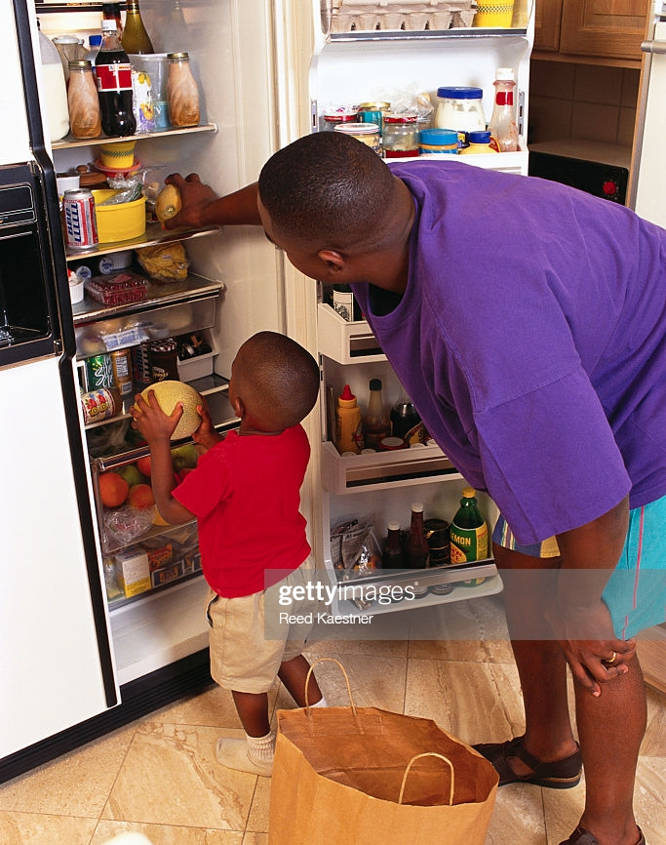
Read and Seed!
Activity!! - Dirt in a Cup
Open your bag!!
Pull out pebbles, dirt, cup and instructions
Read instructions. Let’s read together!
Notes:
Take the taped beans out of the cup.
One finger length pebbles and explain why.
Three finger lengths of dirt in the cup.
Put bean on the dirt.
Cover with one more layer of dirt.
Lightly water.

Slide 10
Questions?
Read and Seed!
Thank you!

