Slide 1
Chapter 2: Ana
Read and Seed
Seedfolks Discussion And Activities

Slide 2
Read and Seed
Today’s Plan
Introductions
Vocabulary
Seedfolks Ch. 2 Discussion
Class Activity
Notes:
Add distractions
Add covid metro regulations

Slide 3
Read and Seed!
Vocabulary
Immigration: moving to a new country
Border: a line that separates two places
Abandoned: left permanently
Suspiciously: not trustworthy
Curiosity: a strong desire to learn something

Slide 4
Read and Seed!
Vocabulary
Immigration
Border
Abandoned
Suspiciously
Curiosity
moving to a new country
left permanently
a strong desire to learn something
not trustworthy
a line that separates two places

Slide 5
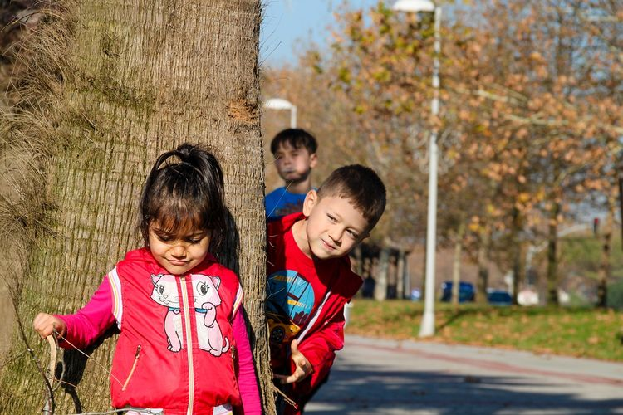
Read and Seed!
Chapter Two: Ana
How long have you lived here?
Why do you think Ana is suspicious of her neighbors?

Slide 6
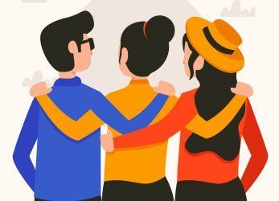
Read and Seed!
Chapter Two: Ana
How would you describe Gibb Street?
What was your favorite part of this chapter?
Where is Lake Erie on your map?

Slide 7
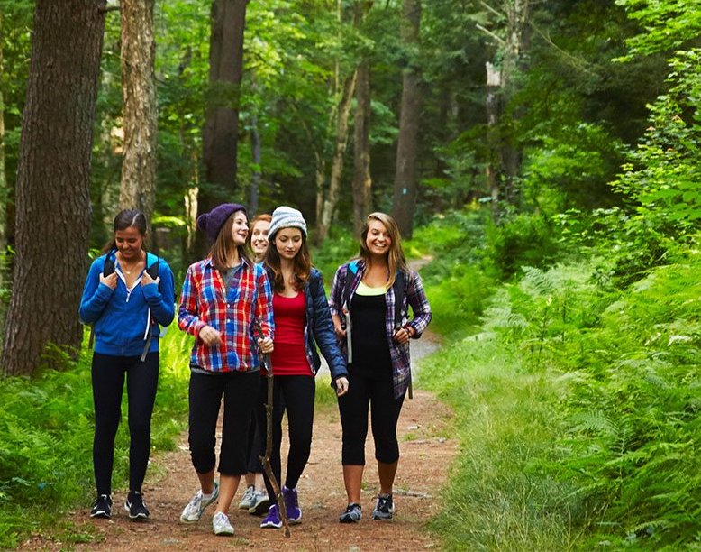
Read and Seed!
Learning on the go - ideas!
Bird Feeders!
You will need your pinecone, peanut butter, string and bird seed

Slide 8
Questions?
Read and Seed!
Thank you!

