Slide 1
Chapter 4: Gonzalo
Read and Seed
Seedfolks Chapter 4: Gonzalo and Activities!

Slide 2
Read and Seed
Today’s Plan
Introductions
Vocabulary
Seedfolks Ch. 4 Discussion
Class Activity
Notes:
Add distractions
Add covid metro regulations

Slide 3
Read and Seed!
Vocabulary
WHAT DO YOU THINK IT MEANS?
Bodega:

Slide 4
Read and Seed!
Vocabulary
Bodega: small corner store or market

Slide 5
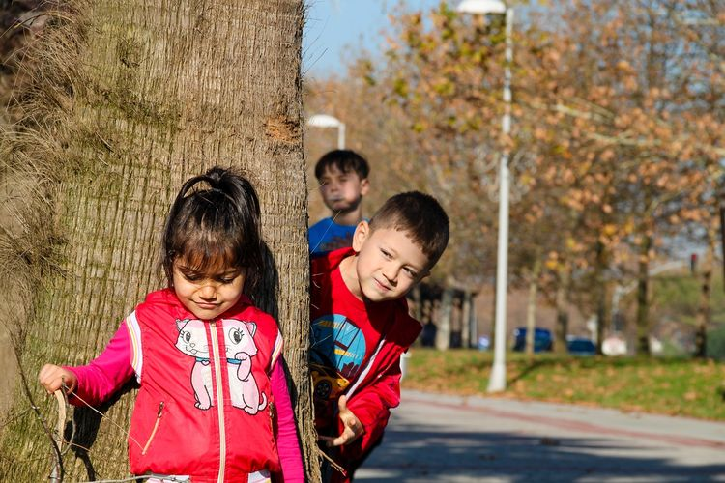
Read and Seed!
Chapter Four: Gonzalo
How did Gonzalo change his view of his family by participating in the garden?
What was your favorite part of this chapter? Why?

Slide 6
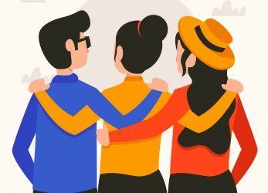
Read and Seed!
Chapter Four: Gonzalo
Gonzalo is from Guatemala. Find Guatemala on your map and put a “G” on it.

Slide 7
Questions?
Read and Seed!
Thank you!

