Slide 1
Chapter 5: Leona
Read and Seed
Seedfolks Chapter 5: Leona and Activities!

Slide 2
Read and Seed
Today’s Plan
Introductions
Vocabulary
Seedfolks Ch. 5 Discussion
Class Activity
Notes:
Add distractions
Add covid metro regulations

Slide 3
Read and Seed!
Vocabulary
Burst: break suddenly
Obituaries: a written notice of death
Recite: repeat out loud
“Precious few”: not very many

Slide 4
Read and Seed!
Vocabulary - Let’s Practice!
Notice of death
Break suddenly
Read out loud
Burst
Obituaries
Recite

Slide 5
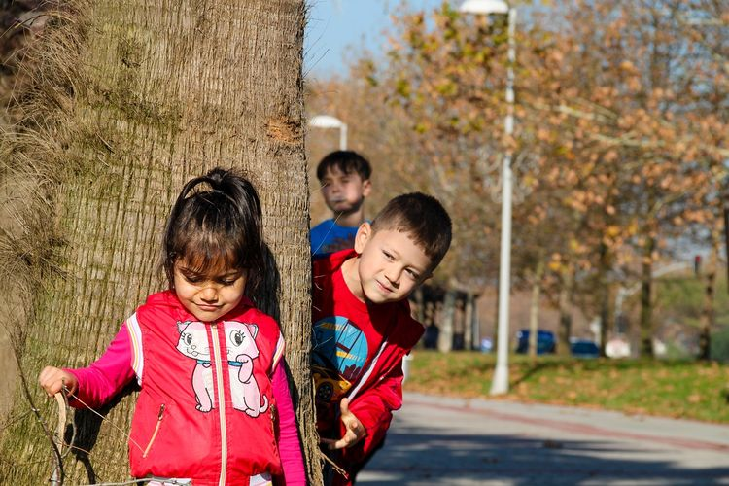
Read and Seed!
Chapter Five: Leona
What does Leona contribute to the garden?
What does Leona teach us?

Slide 6
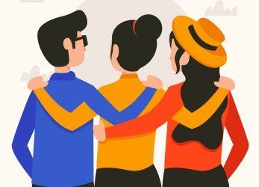
Read and Seed!
Chapter Five: Leona
What was your favorite part of this chapter?
Leona grew up in Atlanta, Georgia. Find Georgia on your map and put an “L” on it.

Slide 7
Questions?
Read and Seed!
Thank you!

